Slide 1
Sentiment Analysis
What is Sentiment Analysis?

Slide 2


Positive or negative movie review?
unbelievably disappointing
Full of zany characters and richly applied satire, and some great plot twists
this is the greatest screwball comedy ever filmed
It was pathetic. The worst part about it was the boxing scenes.
2

Slide 3
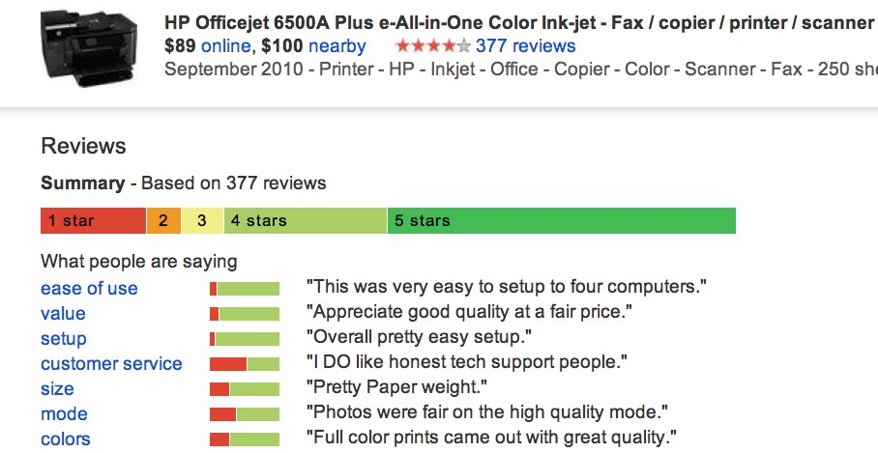
Google Product Search
a
3

Slide 4
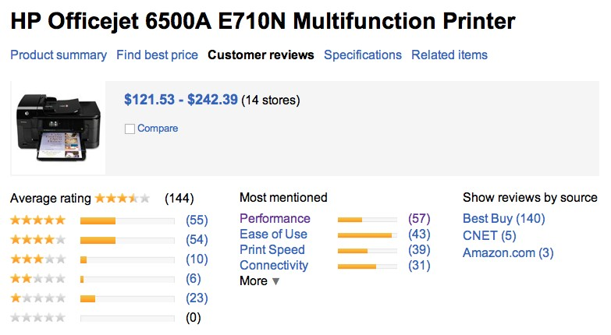
Bing Shopping
a
4

Slide 5
Sentiment analysis has many other names
Opinion extraction
Opinion mining
Sentiment mining
Subjectivity analysis
9

Slide 6
Why sentiment analysis?
Movie: is this review positive or negative?
Products: what do people think about the new iPhone?
Public sentiment: how is consumer confidence? Is despair increasing?
Politics: what do people think about this candidate or issue?
Prediction: predict election outcomes or market trends from sentiment
10

Slide 7
Sentiment Analysis
Sentiment analysis is the detection of attitudes
“enduring, affectively colored beliefs, dispositions towards objects or persons”
Holder (source) of attitude
Target (aspect) of attitude
Type of attitude
From a set of types
Like, love, hate, value, desire, etc.
Or (more commonly) simple weighted polarity:
positive, negative, neutral, together with strength
Text containing the attitude
Sentence or entire document
13

Slide 8
Sentiment Analysis
Simplest task:
Is the attitude of this text positive or negative?
More complex:
Rank the attitude of this text from 1 to 5
Advanced:
Detect the target, source, or complex attitude types

Slide 9
Sentiment Analysis
Simplest task:
Is the attitude of this text positive or negative?
More complex:
Rank the attitude of this text from 1 to 5
Advanced:
Detect the target, source, or complex attitude types

Slide 10
Aspect Based Sentiment Analysis
Aspect-based sentiment analysis (ABSA) is a most practical form of sentiment analysis.
The purpose of Aspect-Based Sentiment Analysis (ABSA), as contrasted to retrieving the general opinion reflected in a block of content, is to retrieve both the aspect defined in the sentence (in this context, the characteristics or attributes of a service or product) as well as the sentiment conveyed towards such aspect

Slide 11
The entire process of ABSA is composed of two main subtasks:
1. Aspect term extraction and
2. Sentiment classification.
First step, Aspect term extraction refers to identifying and retrieving the entity being talked about in a review.
The second step i.e. the sentiment classification deals with classifying various aspects into their polarity categories (positive, negative and neutral).

Slide 12
** Example For English**
Review: The food is good but the location is bad.
Aspect: Term Extraction “food”, “location”
Sentiment classification: food-pos, location-neg
**Example For Hindi**
Review: बैटरी लाइफ बहुत बढिया है
Aspect Term Extraction: बैटरी लाइफ
Sentiment classification: बैटरी लाइफ-pos

Slide 14
Thank you

